Slide 1

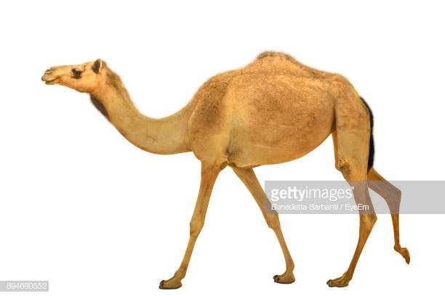
Welcome to Apache Camel Brown Bag

Slide 2
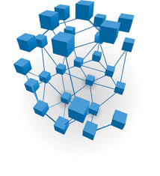
What is integration?
Connecting applications/systems

Slide 3
Terms used in integration
Applications or Systems
Components
Endpoints
Abstractions model end of message channel to send/receive message
HTTP, FTP, File, Messaging, Databases
Message channels
Connect endpoints
Messages are exchanged
Exchange
Contains messages
Input/output messages, CorrelationIDs, MEP, Properties
Message
Contains actual data (business documents), JSON, XML, CSV,
Headers, Attachments, Bodies

Slide 4
How is integration done without frameworks?
HTTP Server
Use HTTPClient object, build boiler plates for connection
JMS
Write a JMSConnection through Factory or Builder
Create a JMS session
Create a producer then send a message
Create a consumer then implement a listener
Datase
Create a connection object using properties
Create a statement
Execute the statement, implement transaction if required

Slide 5
Challenges
Setting up connections are repeatable codes – Boiler plates
Need to cater for connectivity issues
Even if you design your systems as loosely coupled
Dive into individual components to implement exception handling
Need to implement foundations for translations
Set up some corporate patterns
Effectively implement your own integration patterns
Enterprise Integration Patterns
Comprehensive coverage of integration patterns to follow

Slide 6
Integration Frameworks/Platforms
Support and implement EIPs
Some have high level abstractions (business language)
Some support high level abstractions (Fluent APIs, DSLs)
Examples
MuleSoft (Commercial)
WSO2 (Open source & Commercial)
Spring Integration (Open source)
Apache Camel (Open Source)

Slide 7
What do Frameworks/Platforms offer?
Eliminate boiler plates
Through DSLs
Business routes are more compact
Provide easier means to translate your payloads
Abstract errors/exceptions at higher level
Some have integrations with Security Frameworks (IDP), API Consumptions (Commercial ones)
SAML/OAuth2.0 tokens
Track transactions

Slide 8
Challenges with Frameworks
Different methods of integration
Although the EIP patterns are the same
Different terms to different entities
Although high level abstracted
There are occasions where you have to go lower to undertand issues
DSLs are implemented in different languages
Java/Scala/Spring/Groovy, XML, Proprietary

Slide 9
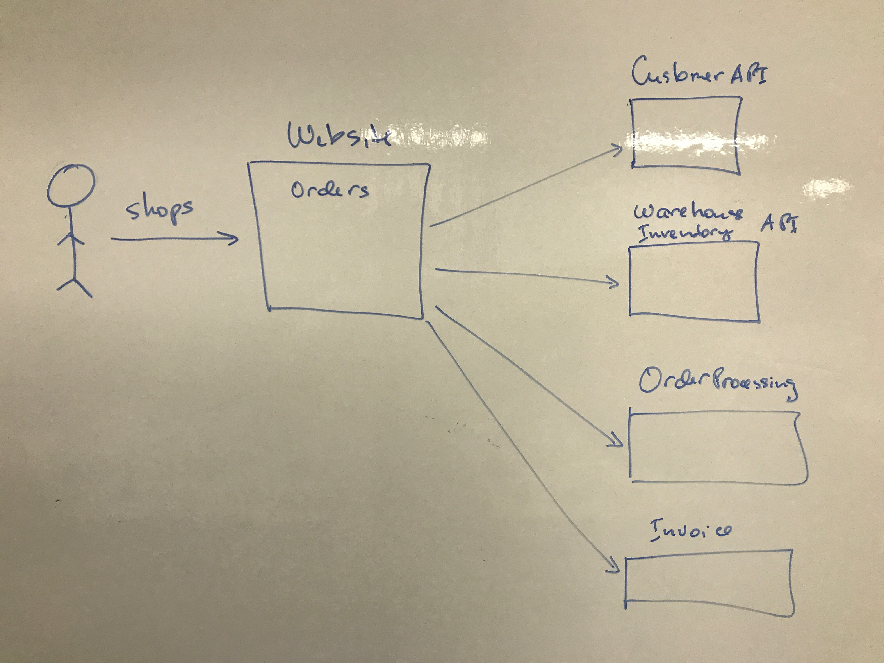
Integration Scenario

Slide 10
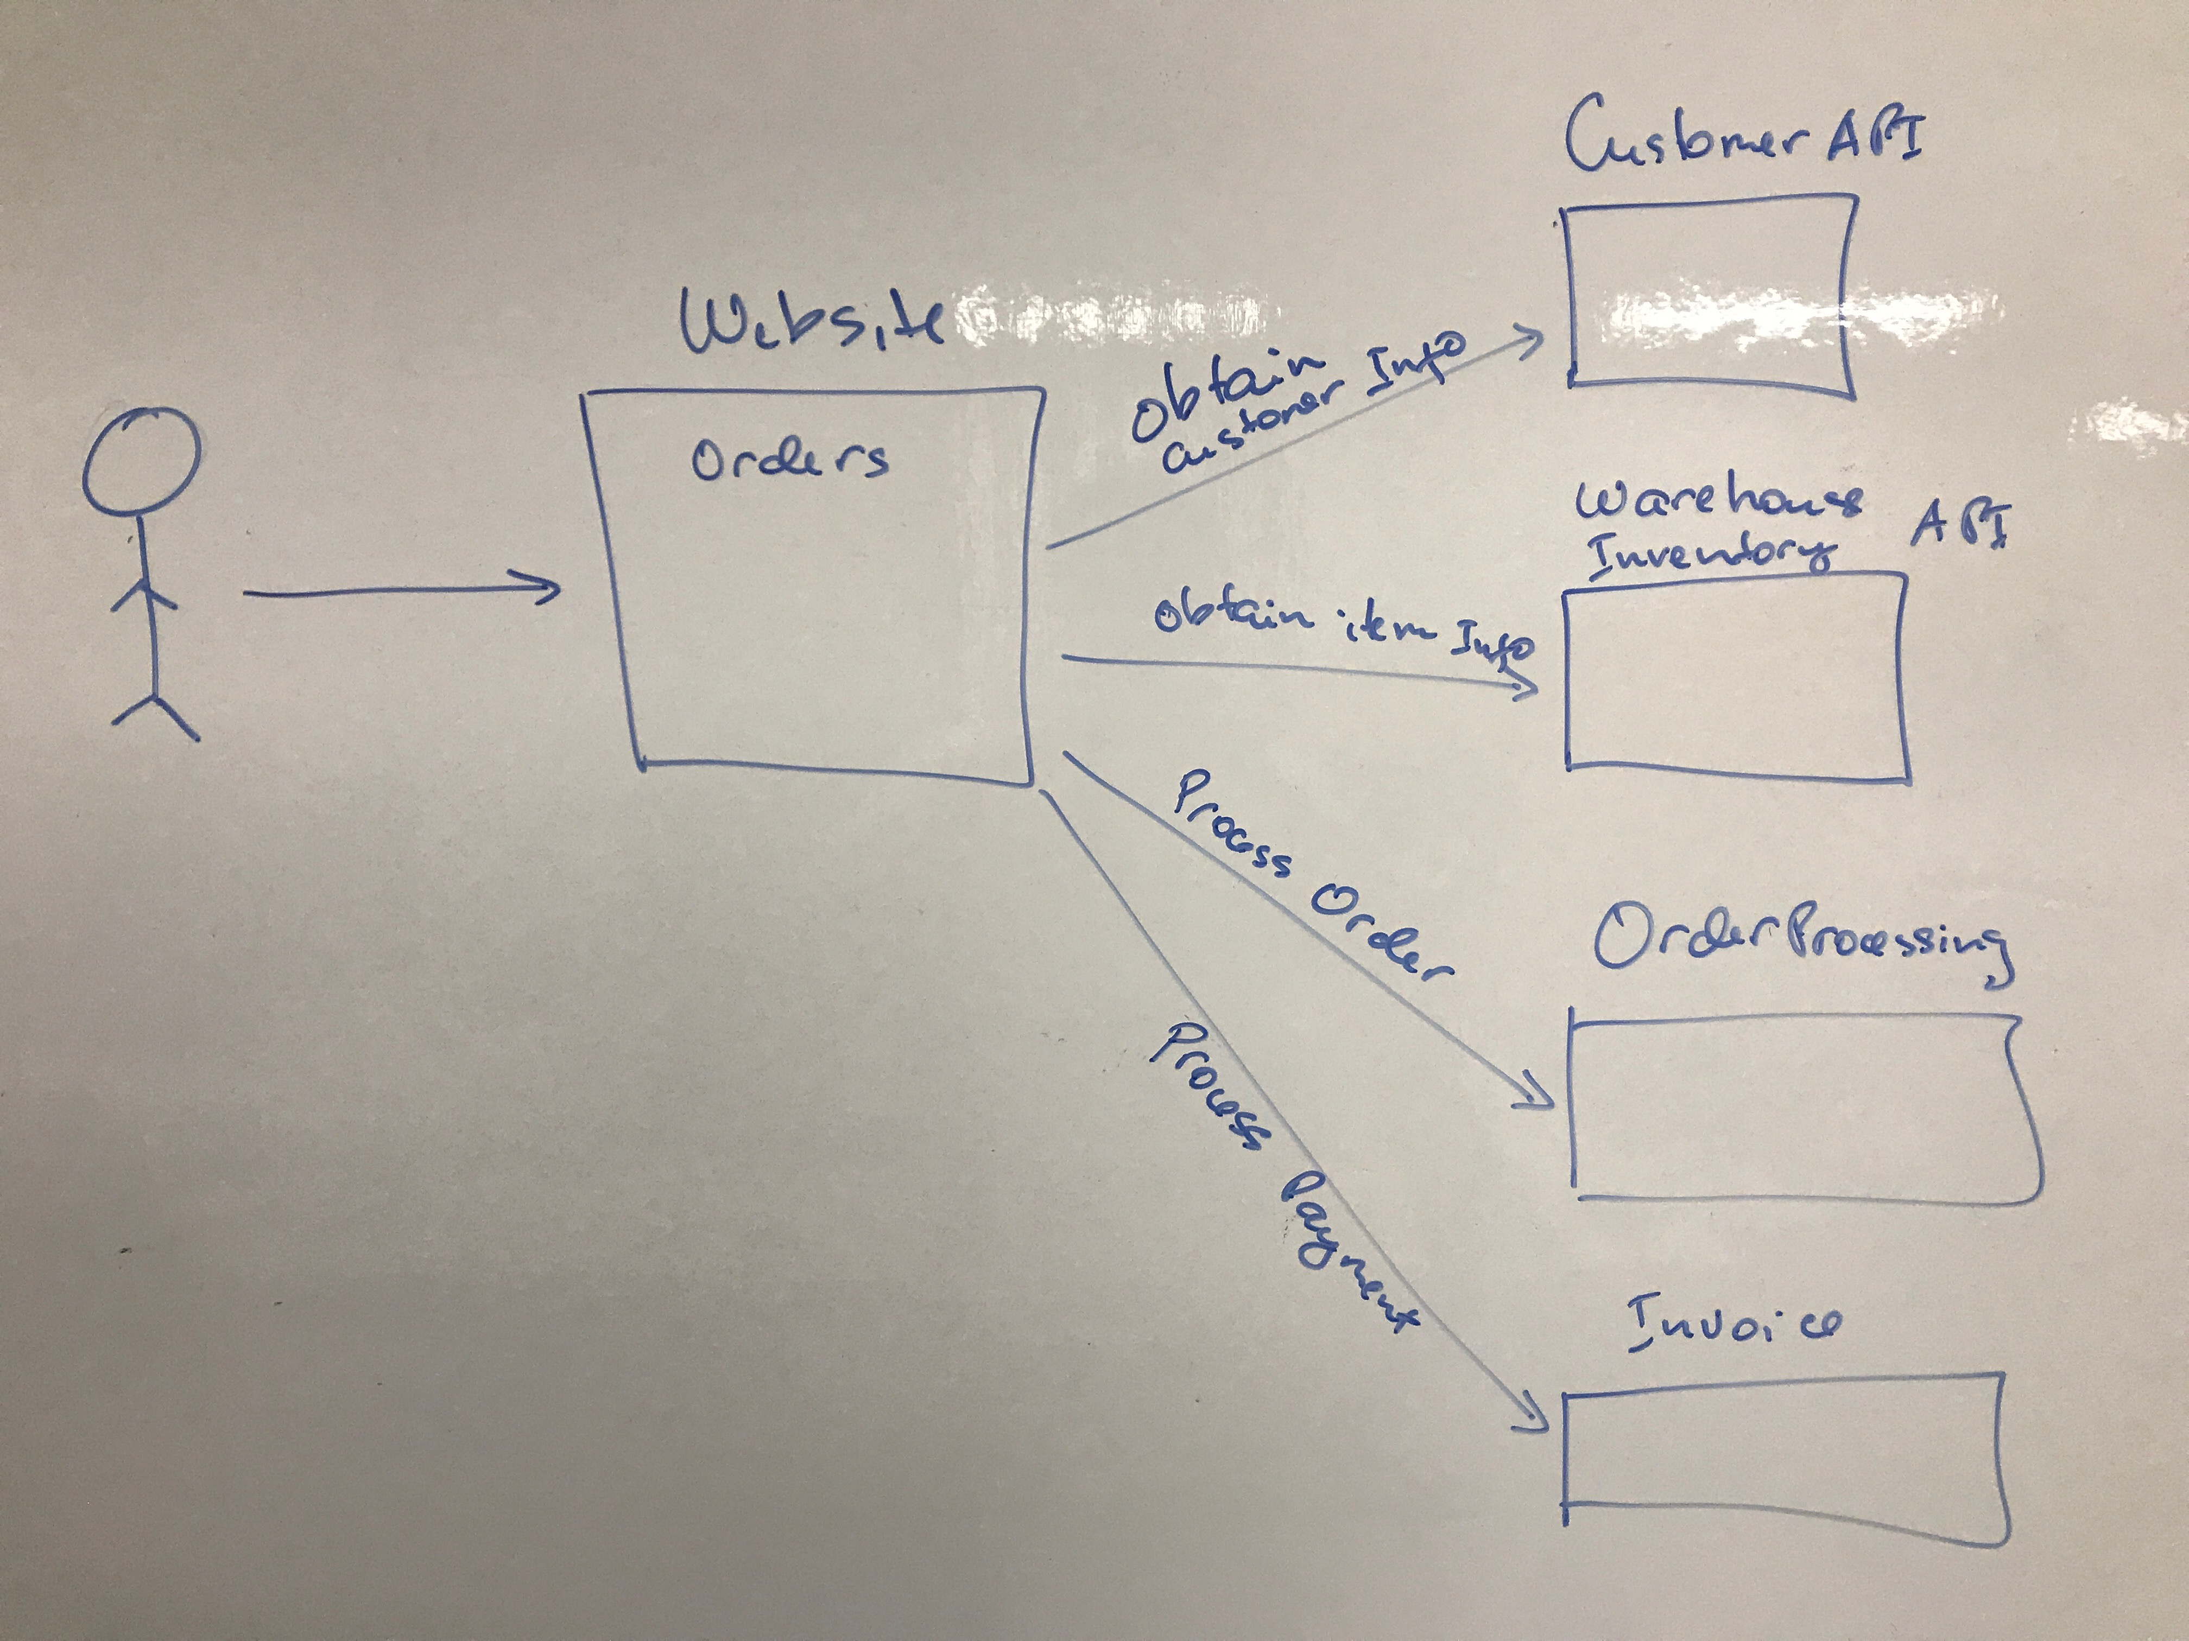

Slide 11
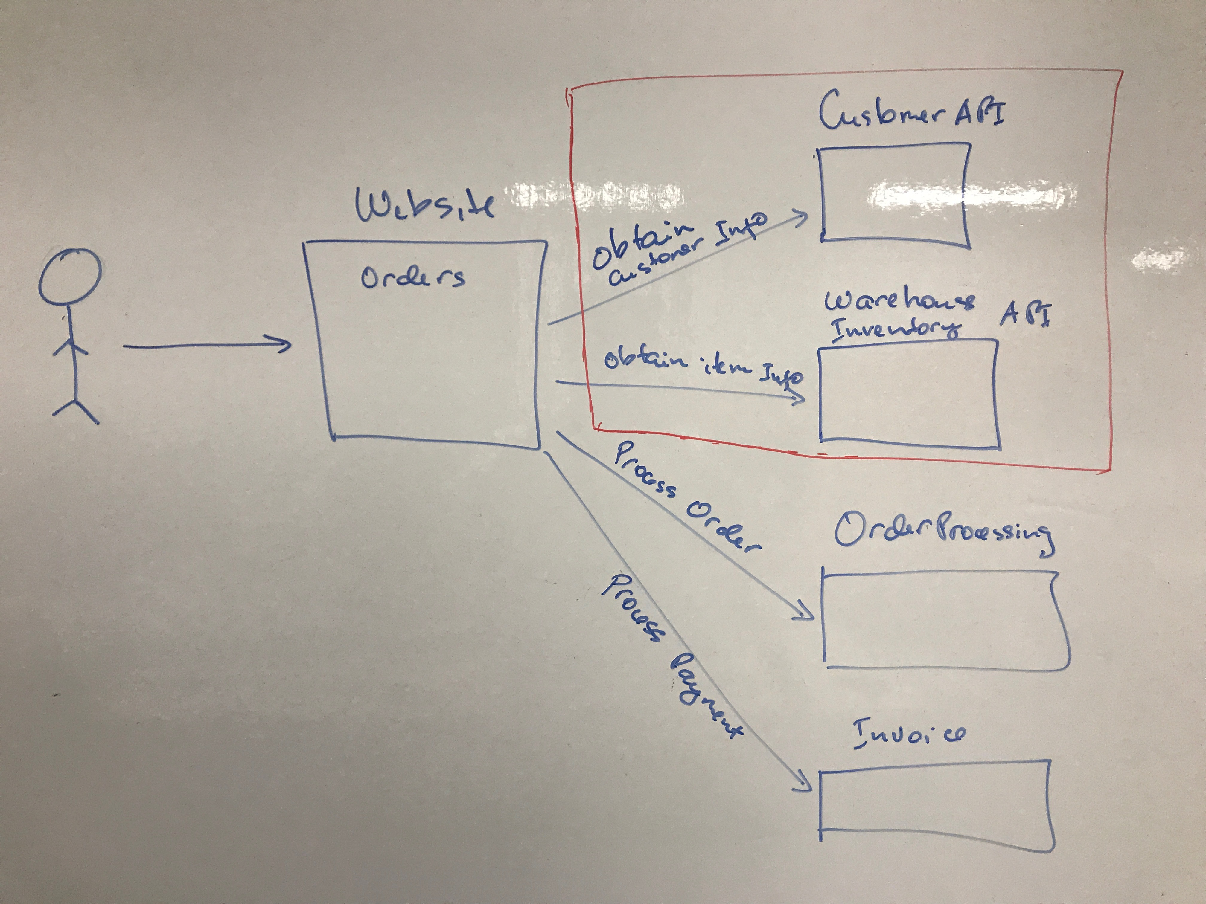

Slide 12
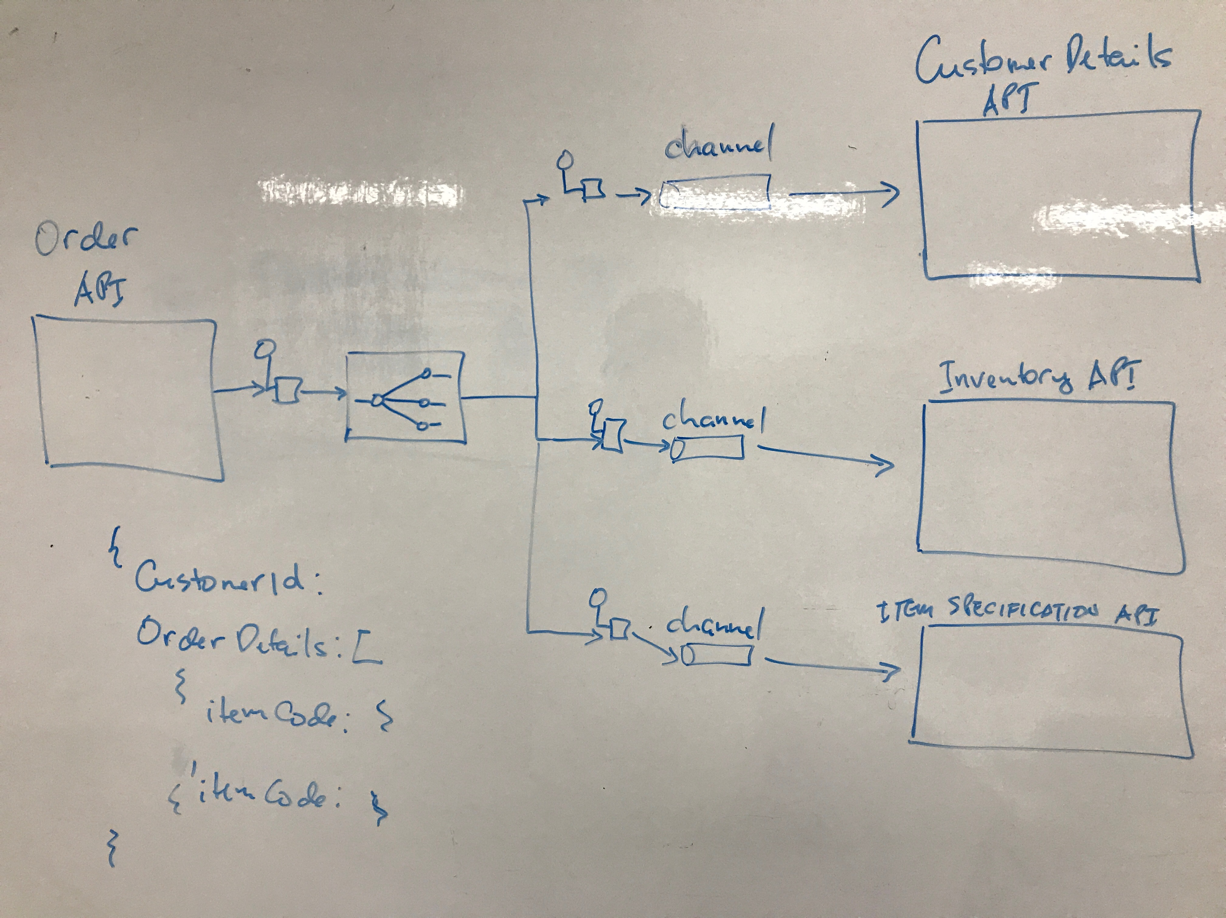

Slide 13
The Application
Spring Boot Rest Application
Order API - POST /order/sync/illustrateDsl
JSON Request Payload
CustomerID
OrderItems
JSON Response Payload
CustomerDetails
OrderItemDetails
Fulifillment API – POST /order/process
JSON Request Payload
Complete Customer Details
OrderDetails
JSON Response Payload
Order Details with Fulfimment Status
Basic Invoicing Information

Slide 14
Systems Integration
OrderValidationService Class
Orchestration Service
Receives payload from the client and send to Camel Route
Communicates with the Camel Context
Gets the response and sends back to the client
What goes on in the Camel Route
Receives the payload
Interacts with different endpoints
Applies Enterprise Integration Patterns
Either returns results based on InOut or OutOnly
Possibly Converts Outputs from one format to anotherSends the payload to the Camel Route

Slide 15
The world of Camel
CamelContext
RouterBuilder
ProducerTemplate

